Slide 1


Prey vs Predators
Prey
Predators
A turn-based tactical AI simulation
CSE 3812 · Overlord7540, Sahriar-Sami, mahnajbintarahman · 3 October 2026
Notes:
Introduce the project: a Python and pygame game where predators hunt prey on a grid, and every animal is driven by an AI controller.

Slide 2
The Game
70%
65%
Predators win
Prey win
by eliminating prey
by eating the food
Turn-based grid · river, rocks, food · 12×10 or 20×20
2 / 12
Notes:
Two sides, two win conditions. Both thresholds are percentages of the starting prey and the starting food.

Slide 3
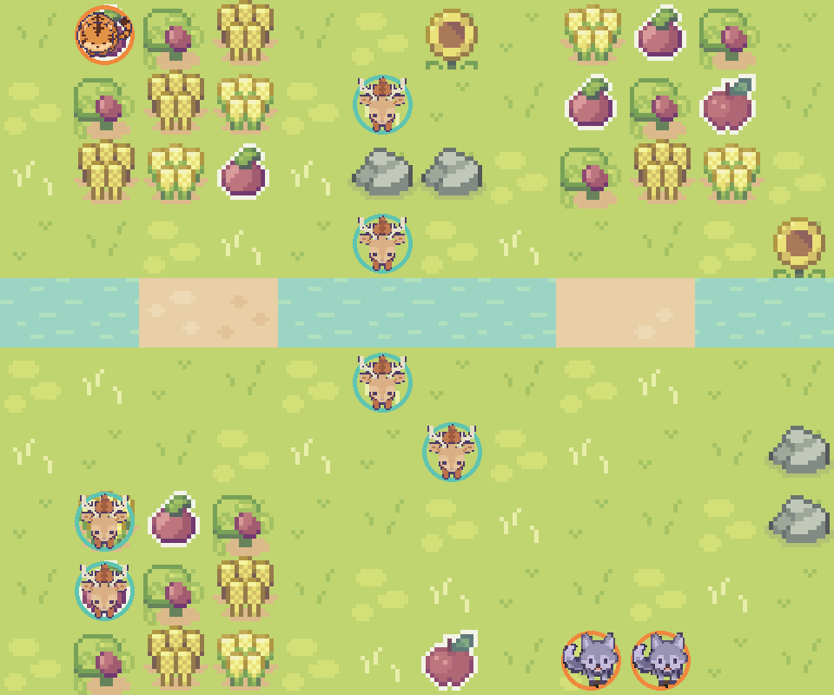


The Game Board
Predators: tiger and wolves
Prey: deer herds
River, crossed at two fords
Crops and fruit are the food
Terrain art: Sprout Lands by Cup Nooble
3 / 12
Notes:
This is the real 12 by 10 riverlands map, rendered from the game's own tiles and sprites with seed 7. The tiger starts top left, the wolves bottom right.

Slide 4
Architecture
Simulation
AI
Display
Rules, grid, turns, combat. No graphics.
Reads what the animal sees. Chooses a move.
pygame draws the state and takes input.
Every AI has one shape: Observation in, Action out
4 / 12
Notes:
Folders: src/core, src/ai, src/rendering. Because the AI only gets a read-only snapshot, it cannot cheat, and matches can run without a window.

Slide 5
One Round
1
2
3
4
Predators act
Prey act
Check win
Log round
Each animal: observe → decide → move → attack or eat
5 / 12
Notes:
turns.py runs this as a Python generator, so the screen can show one action at a time. A human player pauses the loop on their own side.

Slide 6
Prey: State Machine
NORMAL
PANIC
DESPAIR
Walk to the flock's food goal
Predator within 6 tiles: flee
A flockmate was hit: flee and regroup
BFS finds food
A* walks there
fcost picks escapes
6 / 12
Notes:
fcost: each candidate tile is ranked by distance from the predator and by distance to food. The two ranks are added and the highest total wins. Despair swaps the food rank for a regroup rank. The default Tactical AI uses a weighted tile score that also predicts where predators can reach next turn.

Slide 7
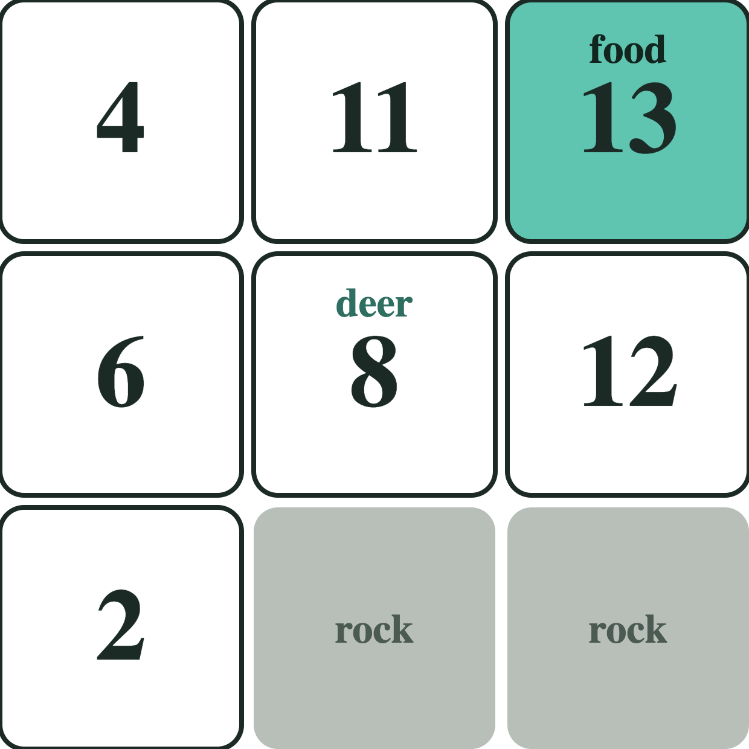
Prey Scoring: fcost
1 Rank tiles by distance from the tiger
2 Rank tiles by distance to food
3 Add the ranks. Highest wins.
Deer moves to the food: 13
Real example from the game: seed 7, round 1. The tiger is 4 tiles to the left.
7 / 12
Notes:
These are the real scores the game's score_moves_fcost_panic function produced for deer_0. The two rock tiles are impassable, so they are not candidates. The deer's own tile scores 8 and the tile next to the tiger side scores lowest.

Slide 8
Predator Tactics
Tiger
Wolves
Combat
Hunts alone. Damage 22–42. Chases after its first kill.
Hunt as a pack. Each takes a different tile around one target.
First hit never kills. Survivors bolt away.
Targets: the weakest prey they can reach
8 / 12
Notes:
Wolf damage is 16–28. Tiger intent is rolled once per match (chase, ambush or camp) with a bias toward camping. A surviving prey gets adrenaline: extra movement and protection until its next turn.

Slide 9
Predator: Hunt Plan
CHASE
AMBUSH
CAMP
Run straight at the nearest prey
Go to the point between prey and its food
Take the far side of the river, then close in
Tactical brain (default): hit the weakest prey in reach, otherwise take the shortest route
9 / 12
Notes:
The three intents belong to the simple Greedy brain. The intent is rolled once per match: tigers lean toward camping, wolves toward ambush. After its first kill a tiger switches to constant chase. Movement uses A star. The default Tactical brain ignores intents: it attacks the reachable prey with the lowest HP, and otherwise follows a shortest-route map that also avoids tiles with high enemy influence.

Slide 10
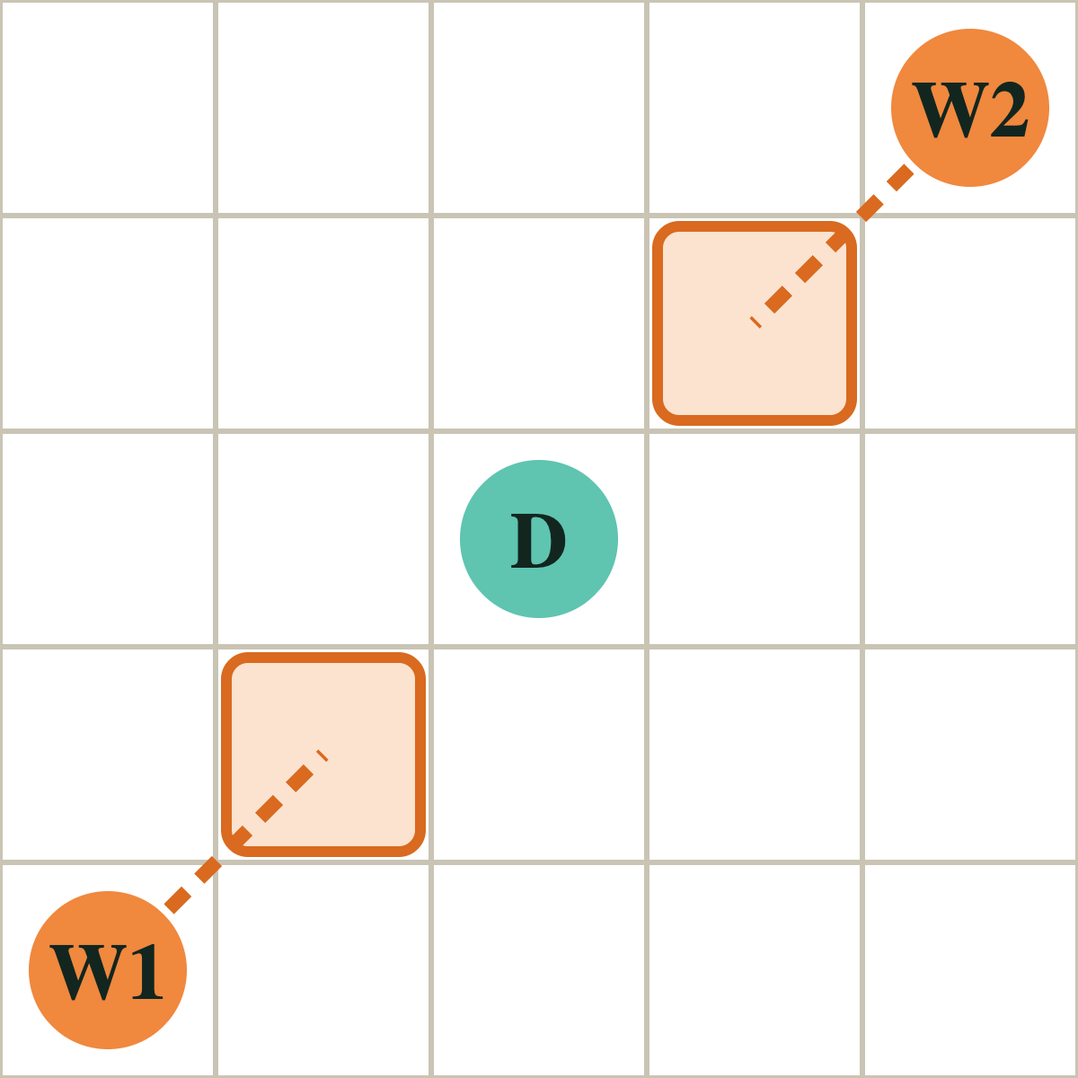
Predator: Wolf Pack
1 Pick the prey the pack reaches cheapest
2 Give each wolf its own tile beside it
3 Prefer approaches far apart
Surround, do not queue
Schematic of the team-hunt rule in the game code
10 / 12
Notes:
This follows coordinated_wolf in the tactics module. It measures every wolf's route length to the free tiles around each prey, picks the prey with the lowest total, then assigns each wolf a different tile, preferring tiles that are far apart. The drawing is a schematic, not a screenshot.

Slide 11
Prey and Predators Side by Side
 | Prey | Predators
Goal | Eat 65% of the food | Eliminate 70% of the prey
Group | Flock shares one food goal | Wolves share one target
Reacts | Panic, then despair | Chase, ambush or camp
Paths | BFS and A* | A* and BFS distance map
Default brain | Scores tiles for safety and food | Hits the weakest prey in reach
11 / 12
Notes:
Both sides use the same Observation and Action contract, so any controller can drive either side.

Slide 12
AI Opponents Compared
Calm · nearest gain
Model | Copy of Wary
Decision tree | 37.5%
Logistic regression | 29.2%
Random forest | 25.0%
Naive Bayes | 16.7%
Markov model | 4.2%
Wary · scored tiles, default
Sharp · REINFORCE, 8→8→1
Classical ML · copy of Wary’s tile, not a win rate
Chance is 4.3%. Only Markov failed to beat it. Hunters then won 19 of 20 games.
12 / 12
Notes:
Accuracy comes from 24 held-out decisions, so treat it as a small sample. The neural policy was trained for 80 episodes, but in the saved evaluation predators won 4 of 4 matches both before and after training, so it did not measurably beat the baseline.

